Slide 1

ADO ASSIGNMENT 2
BY: TRISTAN, LU’LU, CLAYTON, IAN AND SYED
SEEMOOD74

Slide 2
1. Project Objectives
2. Sprint 1
3. Sprint 2
Table of Contents
4. Sprint 3
5. Sprint 4
5. Sprint 5
6. Dashboard and dbt demo

Slide 3
PROJECT OBJECTIVES

Slide 4

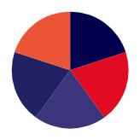



PROJECT OBJECTIVES
modernize North Wind Trader’s (NWT) legacy on premise systems
migrate OLTP system to OLAP for better scalability, speed and reliability
Notes:
So what was the objective of the project?
Our goal was to modernize North Wind Traders legacy on premise systems by migrating OLTP system to OLAP for better scalability, speed and reliability.
Online Transactional Preprocessing
Online Analytical

Slide 5
SPRINT 1
Notes:
For the Sprint 1, Ian Choy was the Scrum Master. As Scrum Masters, we facilitate the Scrum processes, ensuring team adherence to Agile principles. Mentoring team members, remove impediments, manage project timelines, and foster an environment conducive to collaboration and efficient work. Acting as a link between the team and stakeholders.

Slide 6
SPRINT 1 - OBJECTIVES
SPRINT GOAL
Sprint Backlog Item | Story Points
Data Profiling (EDA) | 13
Identify Supplier Reporting Needs | 3
Identify Shipping Reporting Needs | 3
Identify Sales Agent Reporting Needs | 3
Identify Customer Reporting Needs | 5
Identify Sales Reporting Needs | 5
identify reporting needs by understand NWT’s data
Notes:
In Sprint 1, the goal of the sprint was to develop understanding of NWT's database, through the Entity-Relationship Diagram, and ultimately identify their different reporting needs
Story points were assigned to product backlog items through the use of planning Poker.
Hence, these were the chosen sprint backlog items
from our product backlog

Slide 7
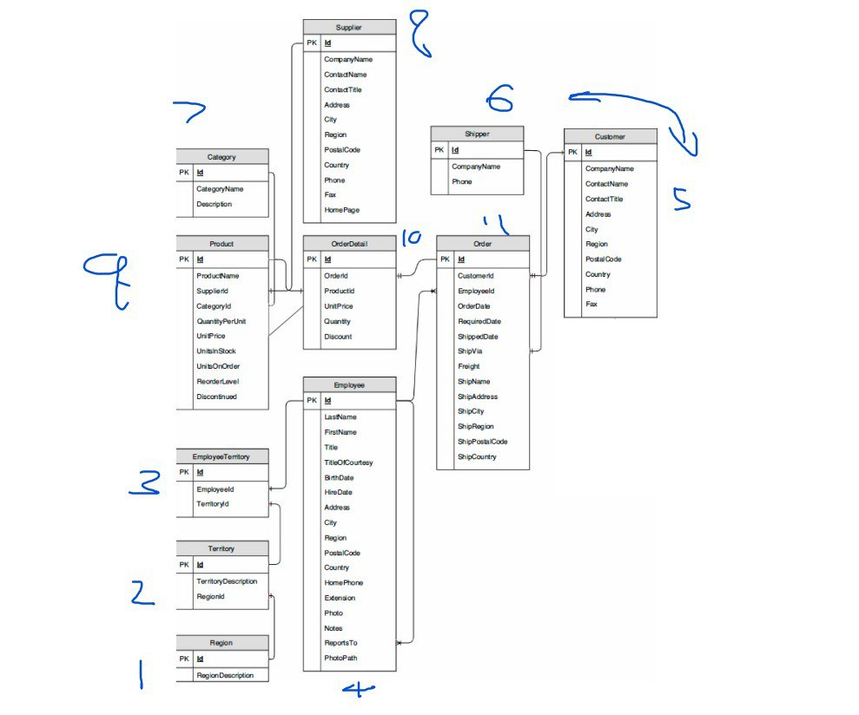
SPRINT 1 - REVIEW
referenced NWT’s ERD (Entity Relationship) diagram
data profiling done to develop understanding of NWT’s dataset, and determining the order to load the tables

Slide 8
SPRINT 1 - REVIEW
USER STORIES
Syed
Tristan
Lu’lu
Clayton
Ian
Shipping Reporting
Shipping costs by companies
Shipping costs by customers
Locations shipped to the most
Delivery rate
Shipping Deadlines
Which companies handle the most expensive orders
Sales Agent Tracking
Tenure vs. Sales Performance
Locations of Sales Agents
How much profits are Sales Agents bringing in
Who are the longest serving
Territories that bring the most value
Average employee values
Customer Reporting
Average order value
Top 5 customers in sales
Top 5 customers in profit
Top 5 customers in orders
Distribution by country
Distribution by city
Total customers by time period
Order receive rate
Sales Reporting
KPIs across regions
KPIs by product category
Profit margin by product category and products
Changes in KPIs
KPIs of products from top 5 companies
Sales volume vs discount amount
Supplier Reporting
Number of Suppliers
Suppliers by city
Suppliers by region
Suppliers by country
Highest delivery rate by supplier
Number of unique products per supplier
Number of discontinued products per supplier
Notes:
These are the reporting needs identified for each of NWTs existing reporting requirements:
who did what:
G: Data Understanding of NWT's data
T: Identify Sales Agent Reporting needs
L: Identify Customer Reporting needs
C: Identify Sales Reporting needs
I: Identify Supplier Reporting needs
S: Identify Shipping Reporting needs

Slide 9
SPRINT 1 - RETROSPECTIVE
Mad
Sad
Glad
Lack of communication between team members led to overlap in work at the start - Ian
Creative bottleneck hindered progress - Syed
Each team member contributed equally -Tristan
Devs were on task and completed sprint quickly - Lulu
Understanding of scrum took time and was difficult - Clayton
Communication improved near the end to prevent overlaps - Ian
Notes:
- Lack of communication between team
- Creative bottleneck when identifying reporting needs-
- Grasping scrum concepts were difficult
Each team member contributed equally

Slide 10
SPRINT 2
Notes:
Syed - Scrum Mater

Slide 11

SPRINT 2 - OBJECTIVES
Sprint Backlog Item | Story Points
Creating Tables in SF | 8
Initialize and Setup Github Repository | 5
Initialize dbt workspace | 3
Creating raw tables in dbt | 8
SPRINT GOAL
Create tables and Load data into Snowflake (SF)
Prepare data for transformations
Notes:
objective of sprint 2 is create and load table into snowflake before preparing for data transformations

Slide 12
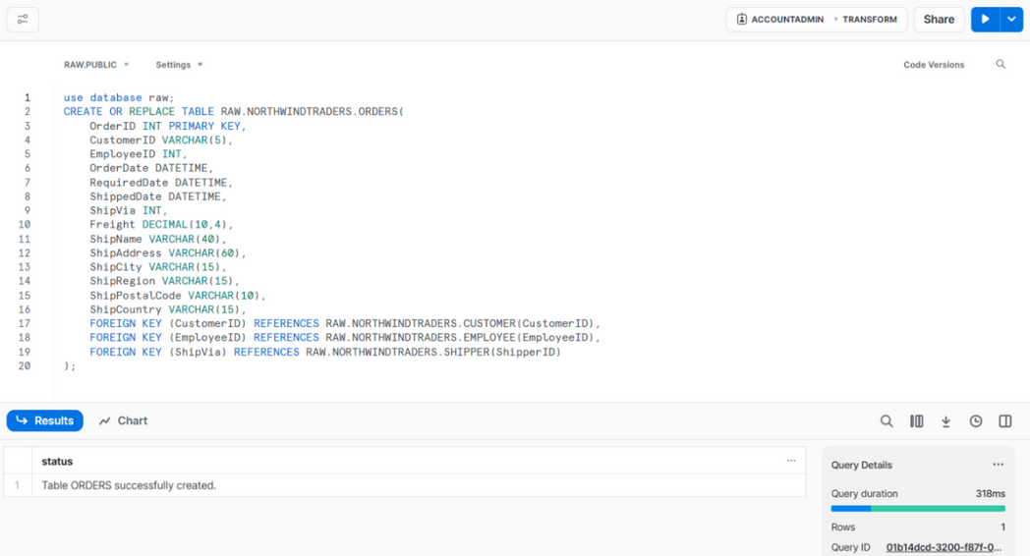
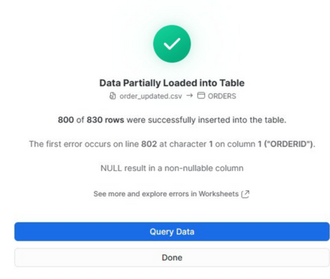
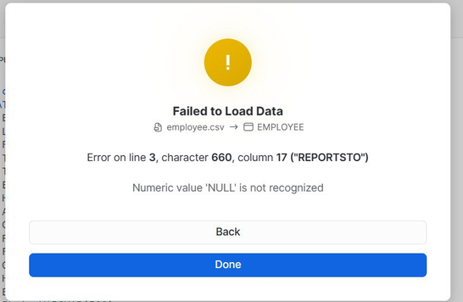
SPRINT 2 - REVIEW
LOADING INTO SF
Tables created in Snowflake before loading
Some tables’ column types had to be changed due to errors in loading
Notes:
Region (Ian)
Territory (Ian)
EmployeeTerritory (Clayton)
Employee (Clayton)
Customer (Lu’lu)
Shipper (Lu’lu)
Category (Tristan)
Supplier (Tristan)
Product (Syed)
OrderDetail (Syed)
Order (Syed)

Slide 13
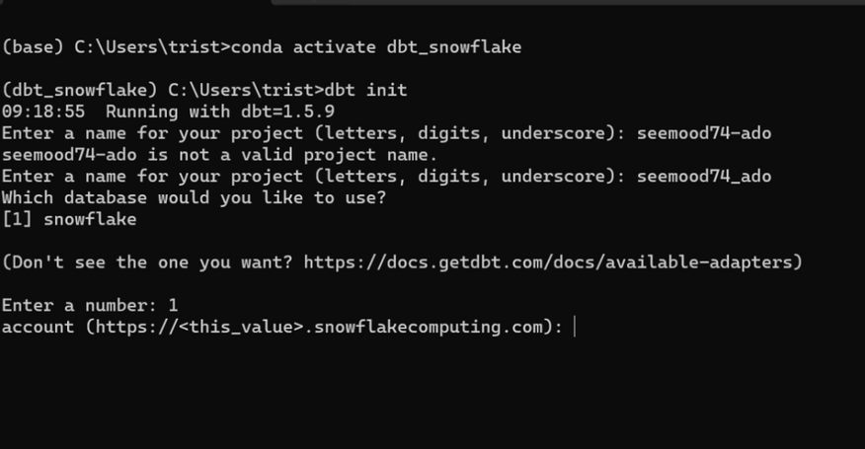
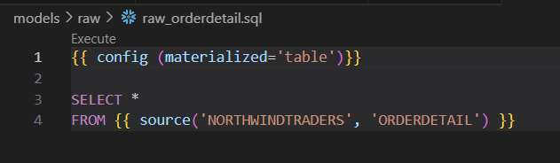
SPRINT 2 - REVIEW
WORKSPACE AND TABLES
Initialized dbt workspace
Created ‘raw’ tables in dbt core
Notes:
Initialized the dbt workspace in anaconda prompt inside dbt_snowflake conda env - from there (tristan)
RAW_Region (Ian)
RAW_Territory (Ian)
RAW_EmployeeTerritory (Clayton)
RAW_Employee (Clayton)
RAW_Customer (Lu’lu)
RAW_Shipper (Lu’lu)
RAW_Category (Tristan)
RAW_Supplier (Tristan)
RAW_Product (Syed)
RAW_OrderDetail (Syed)
RAW_Order (Syed)

Slide 14
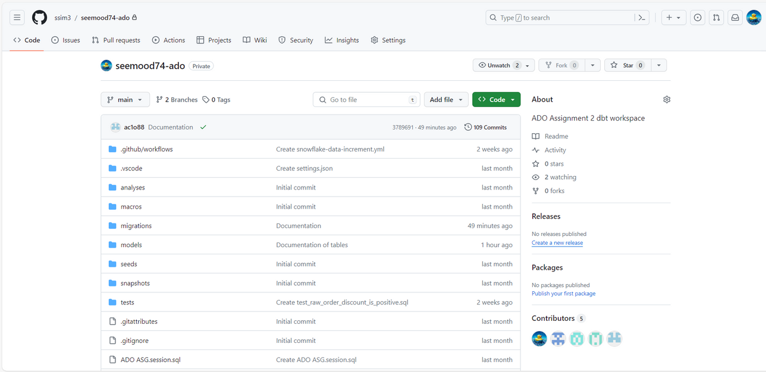
SPRINT 2 - REVIEW
GITHUB REPOSITORY
Version control using github to facilitate collaboration between developers
Notes:
Tristan created github repository

Slide 15
SPRINT 2 - RETROSPECTIVE
Mad
Sad
Glad
unable to engage all members to work on the sprint -Syed
ineffective team collab due to some members being on leave - Ian
team members finally took initiative to hold meetings to do work - Tristan
3 of 5 devs were away for holidays, increasing workload for remaining 2 devs for the first few days - Lulu
team members able to compromise and find time to work together despite busy schedules - Clayton
Notes:
- Several members were on holiday, so we had difficulties collaborating and engaging all team members for meetings
- However, after the Scrum Master emphasized the importance of all developers contributing and meeting on time, the team finally took initiative to find the time to reschedule our meetings and complete the work despite busy schedules

Slide 16
SPRINT 3
Notes:
Clayton - Scrum Master

Slide 17
SPRINT 3 - OBJECTIVES
SPRINT GOAL
Sprint Backlog Item | Story Points
Create testing.yml file | 1
Create tests | 21
Increment RAW ORDERS and RAW_ORDERDETAIL with new data provided | 10
Remove unnecessary columns | 5
Impute missing values | 3
Documentation on dbt | 5
data cleansing and transformations to ensure the quality and integrity of NWT’s data

Slide 18
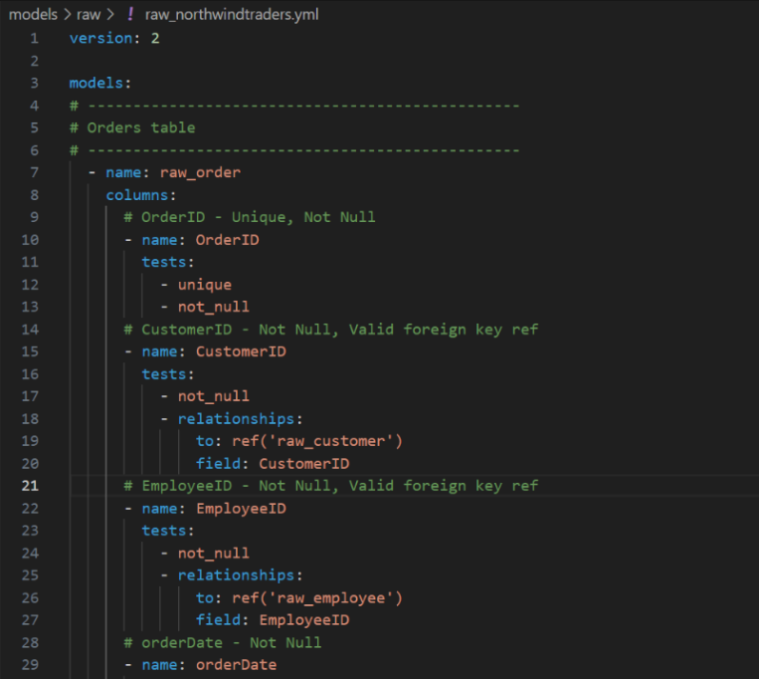
SPRINT 3 - REVIEW
DATA TESTS
made raw_nortwindtraders.yml file for tests
data was tested for null values, entity and referential integrity, negative values, etc.
Notes:
T: Order, Orderdetail, Shipper
L: Region, Territory
C: Product, Category
I: Supplier, Customer
S: Employee, EmployeeTerritory

Slide 19
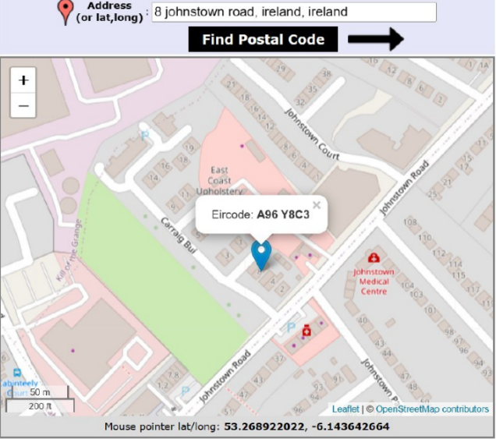
SPRINT 3 - REVIEW
DATA CLEANSING
missing values were imputed where needed, appropriately
e.g. ship postal code was null, the postal code was found online and imputed
Notes:
Syed

Slide 20
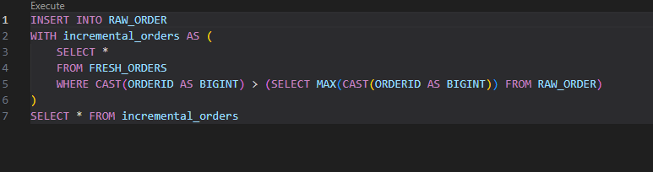
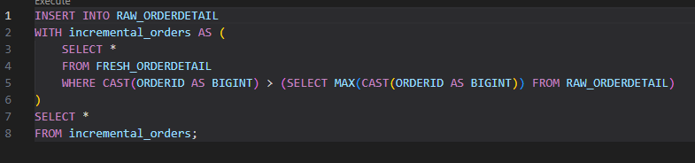
SPRINT 3 - REVIEW
INCREMENTING NEW DATA
new order data was provided, hence the data needed to be updated
utilized incremental models to append the data
Notes:
Ian and Lu'lu created incremental models to append the fresh orders (ORDERS_FRESH) and their respective order details to the RAW_ORDERS and RAW_ORDERTAILS table.

Slide 21
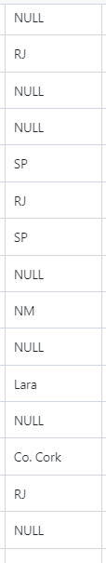
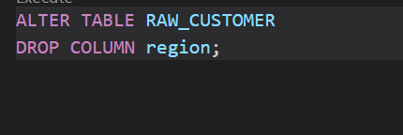
SPRINT 3 - REVIEW
REMOVING REGION COLUMNS
As the Region Columns in all our tables had discrepancies in the format (e.g. ISO2 Format, and others are in its full name)
We decided to get rid of the region table columns as they did not add any value if their values are not in the same format
Notes:
Tristan - Drop Region Table
Clayton - Drop Region columns Employee
Lu'lu - Drop Region in Customer

Slide 22
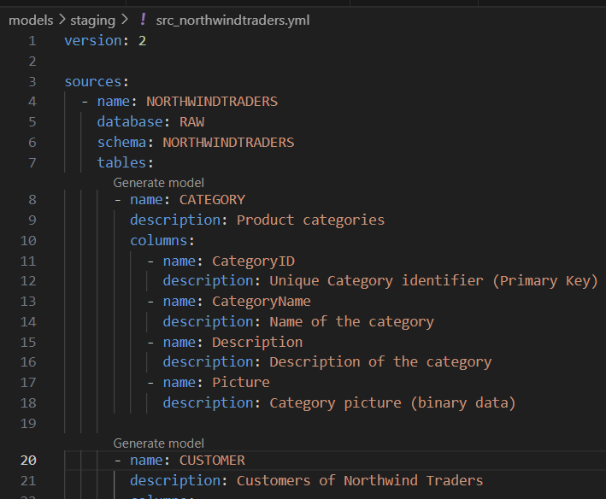
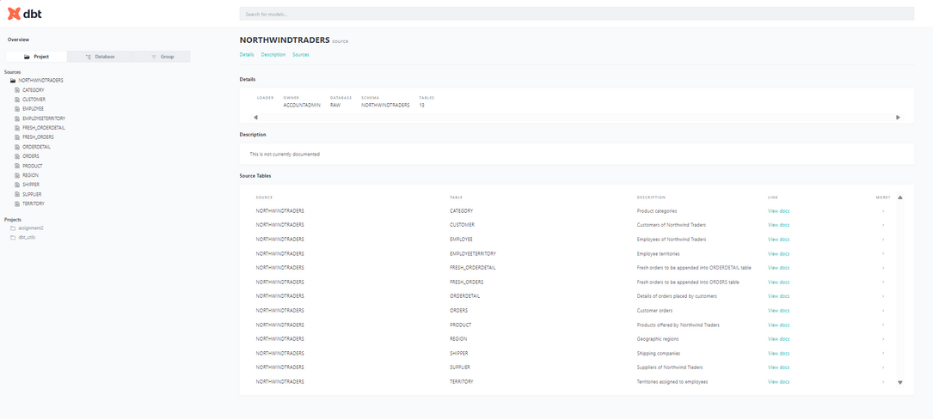
SPRINT 3 - REVIEW
DOCUMENTATION
fill information on all columns in dbt core
generate documentation online
Notes:
syed- documentation was generated with dbt docs to generate documentation online on the ELT process done on the data

Slide 23
SPRINT 3 - RETROSPECTIVE
Mad
Sad
Glad
team was unable to come to an agreement for delegating testing of tables -Lulu
team was not consistent in standardizing of formatting -Ian
team managed to understand incremental models and execute it -Clayton
difficulties delegating tasks at first - Tristan
team was able to compromise and communicate to delegate tasks -Syed

Slide 24
SPRINT 4

Slide 25
SPRINT 4 - OBJECTIVES
SPRINT GOAL
Sprint Backlog Item | Story Points
Create staging file for reporting | 13
Create reports from staging file | 8
Connect Snowflake to PowerBI | 3
PowerBI and Snowflake integration
Notes:
T:
L:
C:
I:
S:
in sprint 4, the sprint goal is to integrate powerbi and snowflake. for this sprint, creating the staging file for reporting was assigned 13 points as it was not a straightforward process, creating reports from staging file was assigned 8 points as it requires meticulous attention for specific requirements, and lastly connecting snowflake to powerbi is awarded 3 popints due to its low complexity.

Slide 26
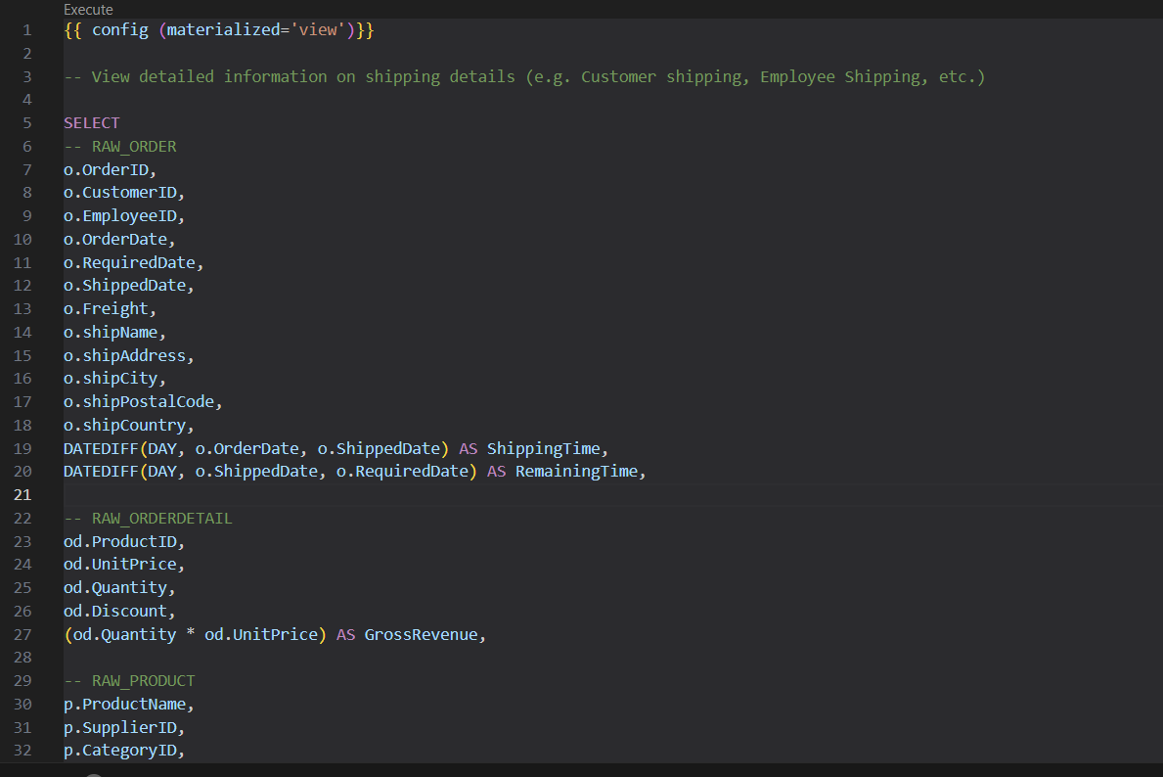
SPRINT 4 - REVIEW
STAGING FILE
create staging file to be used for reporting
join raw tables to one file
Notes:
so for staging, initially we planned to create staging files where the raw tables are merged into one staging file for reporting before importing the resulting schemas into powerbi. me clayton and tristan discussed and worked together on one laptop to create the staging file.
however, we ultimately decided to use the raw tables instead for dashboard creation as we faced challenges in merging the tables together during staging. It is also more efficient and convenient to manage the relationships between tables in powerbi.

Slide 27
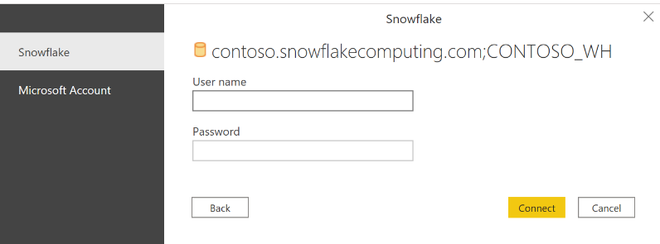
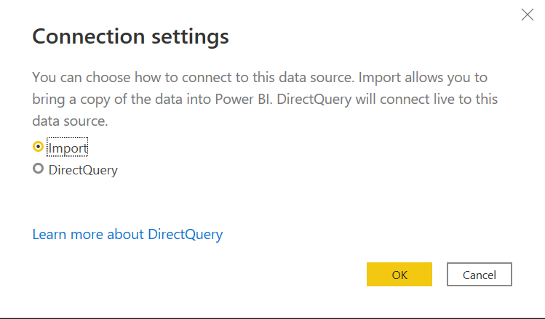
SPRINT 4 - REVIEW
LINK SF TO PBI
PowerBI and Snowflake integration can be done directly
Used DirectQuery to stream real-time data from Snowflake
Notes:
afterwards, syed and ian linked snowflake to powerbi and used direct query to connect to stream real time data from snowflake

Slide 28
SPRINT 4 - RETROSPECTIVE
Mad
Sad
Glad
Team members had difficulties grasping and understanding of the dbt process - Tristan
We did staging but ended up not utilizing it - Tristan
Team was able to finally have a common understanding of where we are in the project - Ian
A lot of confusion on whether to use the raw tables into PowerBI or use views from staging
- Lu'lu
Able to get a somewhat good understanding of how staging and reporting works in dbt - Clayton
Able to overcome team members difficulty to wrap head around dbt process through repeated informing - Syed

Slide 29
SPRINT 5

Slide 30
SPRINT 5 - OBJECTIVES
Sprint Backlog Item | Story Points
Append “PRODUCT_FRESH” to “RAW_PRODUCT” using Github Actions | 8
Incremental Models using Github Actions | 8
Data Cleansing & Transformation using Github Actions | 5
Sales Agent Analytical Dashboard | 13
Customer Analytics Dashboard | 16
Shipping Analytics Dashboard | 15
Supplier Analytics Dashboard | 16
Sales Analytics Dashboard | 16
SPRINT GOAL
CI/CD (Continuous Integration/ Continuous Delivery) Pipeline
Create dashboards based on reporting needs

Slide 31
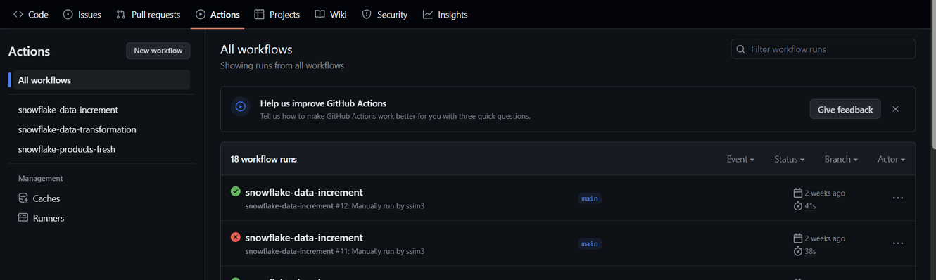
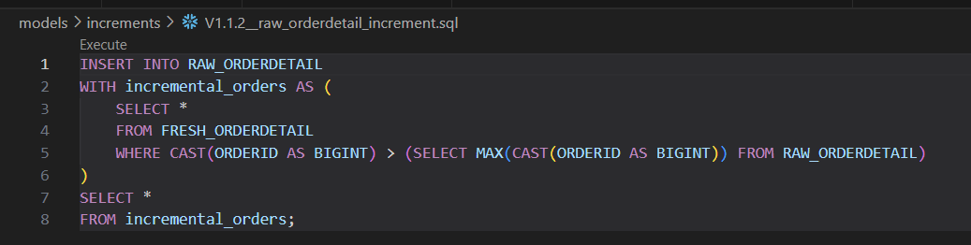
SPRINT 5 - REVIEW
CICD PIPELINE
Products Fresh Data was merged with Products through the use of Github Actions
Github Actions was also utilized to automate data transformation, and incrementing of data from fresh orders ( week 3 )
Notes:
Append Product Fresh columns to RAW_PRODUCT
(Tristan)
Data Transformation (CI/CD)
Syed - Null Shipping Postal Code
Ian - Dropping of Region columns
Data Transformation (CI/CD)
Clayton & Lu'lu - Creating github actions for incrementing fresh orders data

Slide 32
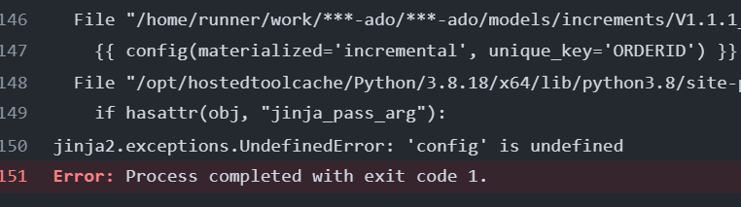
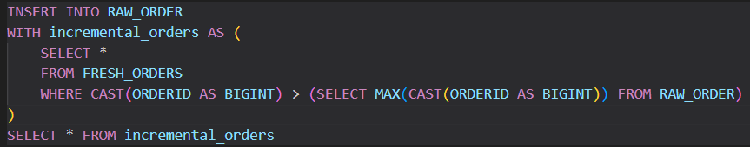
SPRINT 5 - REVIEW
Bugs Faced
Notes:
Append Product Fresh columns to RAW_PRODUCT
(Tristan)
Data Transformation (CI/CD)
Syed - Null Shipping Postal Code
Ian - Dropping of Region columns
Data Transformation (CI/CD)
Clayton & Lu'lu - Creating github actions for incrementing fresh orders data

Slide 33
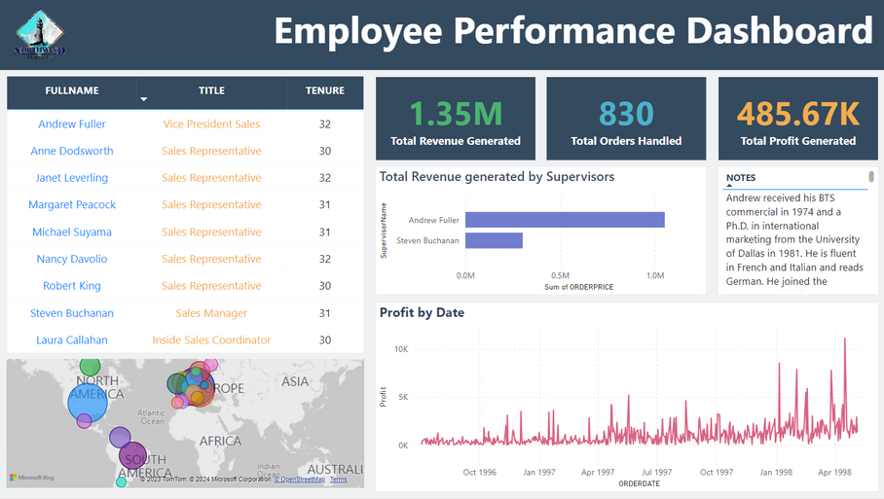
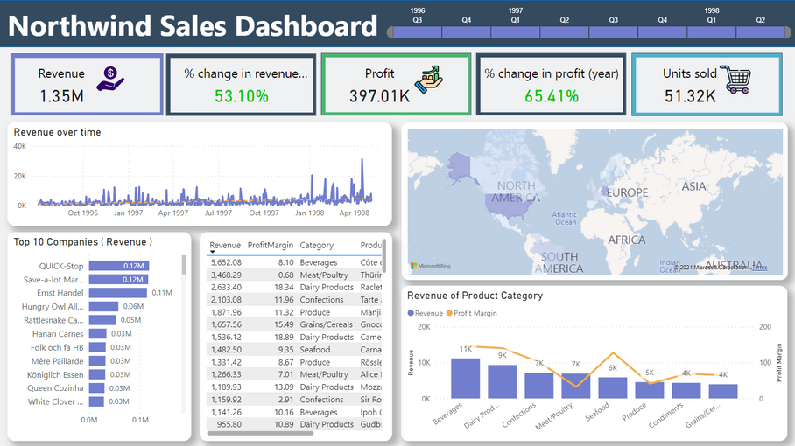
SPRINT 5 - REVIEW
DASHBOARDING
Each of us developed dashboards pertaining to NWT’s reporting needs
Notes:
Tristan - Sales Tracking
Clayton - Sales
Lu'lu - Customer
Syed - Shipping
Ian - Supplier Reporting

Slide 34

SPRINT 5 - RETROSPECTIVE
Mad
Sad
Glad
difficulties grasping different syntax between dbt and snowsql - Clayton
creative bottleneck when discussing dashboard designs -Tristan
team members shared DAX formulae as needed, showing collaborative spirit - Clayton
self directed work but was still efficient -Syed
team was able to finish creating dashboards on time -Lulu
devs finished their own dashboards without relying on others -Ian

Slide 35
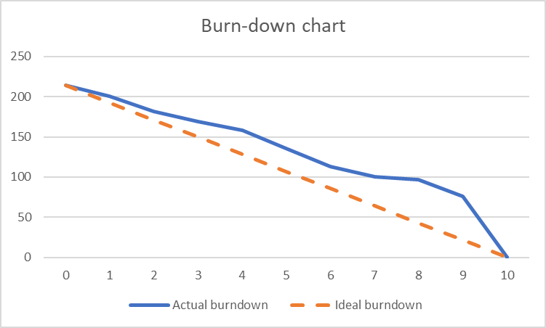
FINAL BURNDOWN
Remaining effort
Week

Slide 36


DASHBOARD AND DBT DEMO

Slide 37
THANK YOU
SEEMOOD74

